Slide 1


Predict If a Customer is Likely
To Buy Travel Insurance
Swaraj Gupta (239544 )

Slide 2
Travelling is an experience full of fun and adventure.
While everyone wants to spend their vacations exploring new places and trying local delicacies, mishaps might always creep in! How can one stay protected against them?
Here is where travel insurance comes in! From accidents to medical emergencies, travel insurance assists clients in all these scenarios and more.
This ensures that clients can leave the worrying to the insurance company and experience their vacation to the fullest

Slide 3
Objective
The objective of this project is to develop a predictive model using Python that can accurately forecast whether a customer is likely to purchase travel insurance. This entails:
Data Collection and Preprocessing
Model Development
Model Evaluation

Slide 4
Technology Used
Google Colab
Python
Pandas
Sklearn
Matplotlib

Slide 5
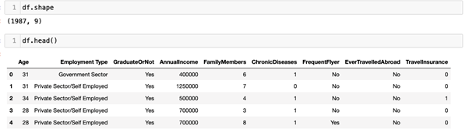
Data Collection and Preprocessing
Gather relevant data on customer demographics, travel history, and other pertinent features. Clean and preprocess the data to ensure accuracy and consistency.

Slide 6
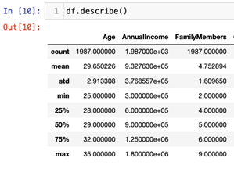
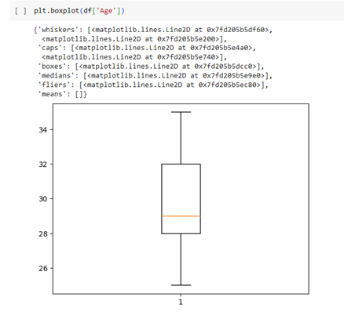
Data Collection and Preprocessing
Outlier Treatment: The first step in removing outliers involves identifying them within the dataset. Outliers are data points that significantly deviate from the rest of the observations.

Slide 7
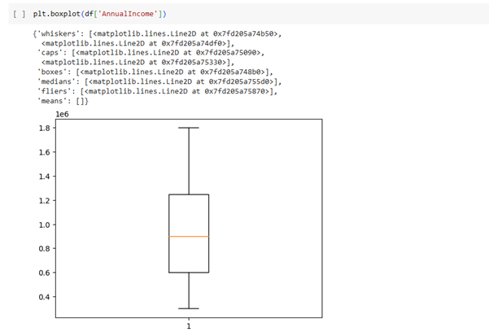
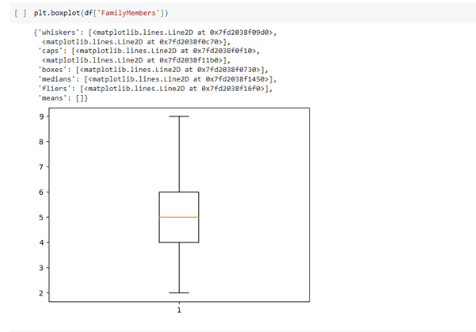
Data Collection and Preprocessing
Common techniques for detecting outliers include statistical methods such as interquartile range (IQR), or visualization methods like box plots.

Slide 8
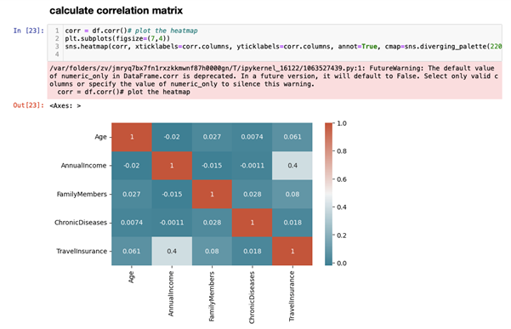
Data Collection and Preprocessing
Correlation Matrix: A correlation matrix is a tabular representation of the correlation coefficients between variables in a dataset.

Slide 9
Model Building
And Evaluation
Logistic Regression
Support Vector Machine
Random Forest
GridSearch CV

Slide 10
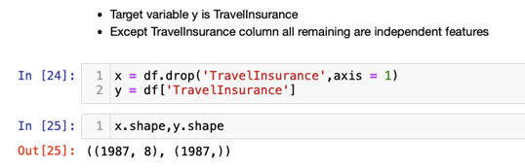
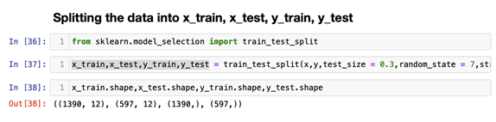
Model Building And Evaluation
Splitting the data in training data and testing data

Slide 11
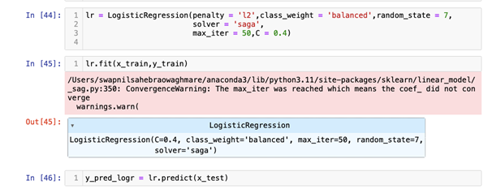
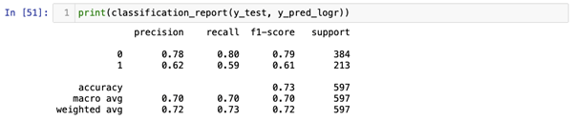
Model Building And Evaluation
We are using GridSearch to fine tune the parameters of algorithm
Logistic Regression:

Slide 12
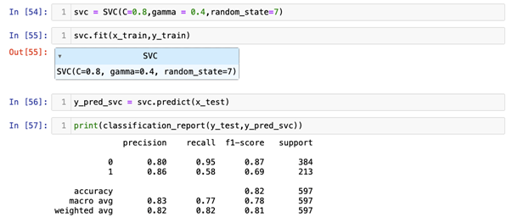
Model Building And Evaluation
Support Vector Machine:

Slide 13
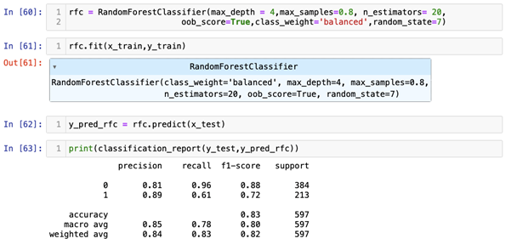
Model Building And Evaluation
Random Forest:

Slide 14
Conclusion
Among the three classifiers i.e. logistic regression, support vector machine and random forest the maximum accuracy is of random forest model (83%).
Hence the best model for classification for given dataset is Random Forest.

Slide 15
Future Scope
Enhance model accuracy through continuous refinement and optimization.
Work with travel experts to make sure the model knows what it's doing
Conduct in-depth analysis of customer behaviors and interactions with insurance offerings to identify patterns and trends.
Develop personalized insurance plans based on customer preferences and risk profiles.

Slide 16
References
https://pandas.pydata.org/docs/
https://scikit-learn.org/stable/
https://scikit-learn.org/stable/modules/generated/sklearn.linear_model.LogisticRegression.html
https://scikit-learn.org/stable/modules/svm.html
https://scikit-learn.org/stable/modules/generated/sklearn.ensemble.RandomForestClassifier.html

Slide 17
Thank You

